Slide 1
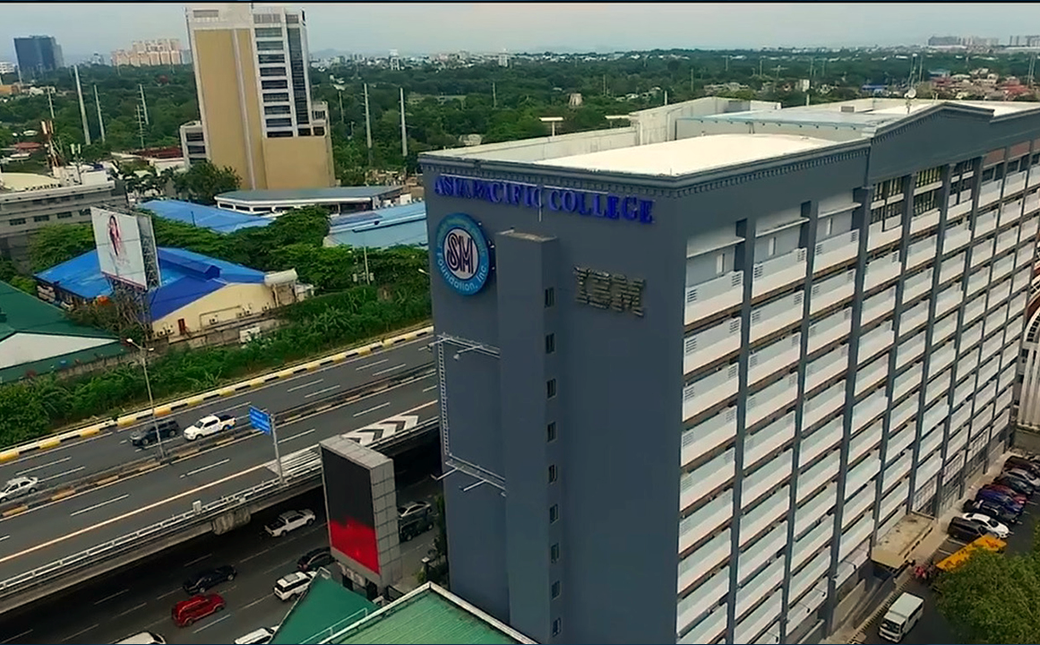
Chambers of the Burning Ashes System (Cbas)
Team Phishda

Slide 2
AGENDA
Brief summary of Cbas
6
activity flow diagram
1
2
Comments Matrix
7
Entity relationship diagram
3
objectives
8
prototype
4
Data Flow Diagram
9
group contributions
5
Use Case & fully dressed

Slide 3

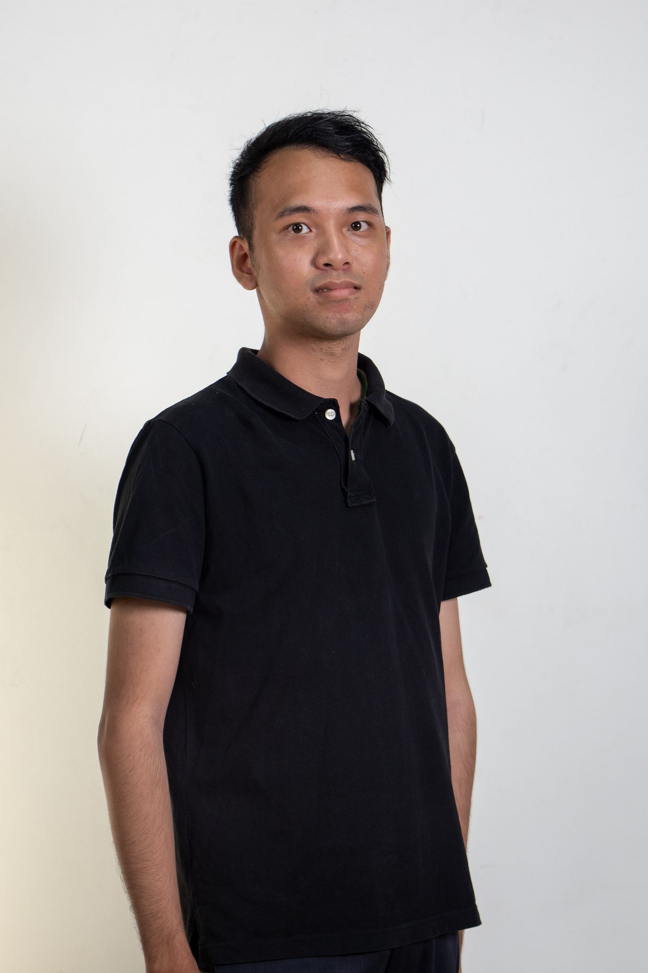

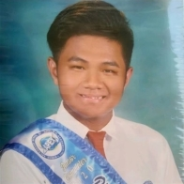

Meet the Team
Team Representative/Frontend Developer
Documentations/Frontend Developer
Documentations/Backend Developer
TEAM LEADER/Backend
Jacob De Villa
Janson crisostomo Pagharion
David Naldo
Kyle Philippe santos

Slide 4
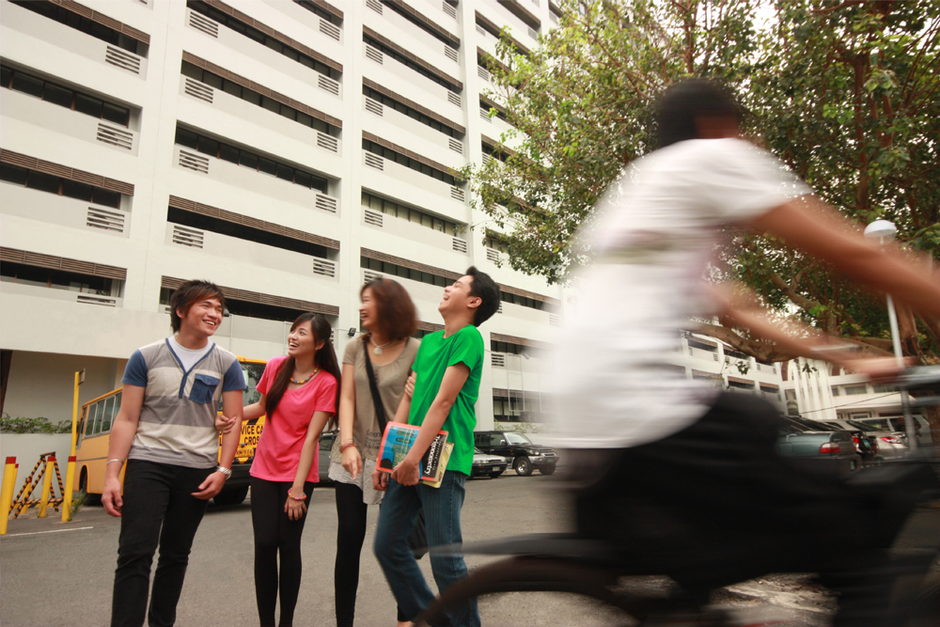
Brief summary of cbas
Team Phishda

Slide 5


The Chambers of the Burning Ashes System is a web-based system meant to help centralize the management and to ensure tracking of vaults .From physical and Excel-based records to a secure, centralized database with integrated backup and encryption features, the parish can enhance better service delivery.

Slide 6
Comments matrix
Team Phishda

Slide 7
Comments
Inconsistencies in Data Flow Diagram and Fully-Dressed Use Case Diagram
Level 2 DFD lack data flowing on the lines and there are no triggers to the data stores
Lack of group collaboration

Slide 8
objectives
Team Phishda

Slide 9

Objectives
Develop a system that can accurately track each transaction, and the documents required to acquire an available columbary
Create a platform for customers that will allow them to securely retrieve their columbary information.
Provide an environment where customer data can be backed up digitally.

Slide 10
Data Flow Diagram
Team phishda

Slide 11
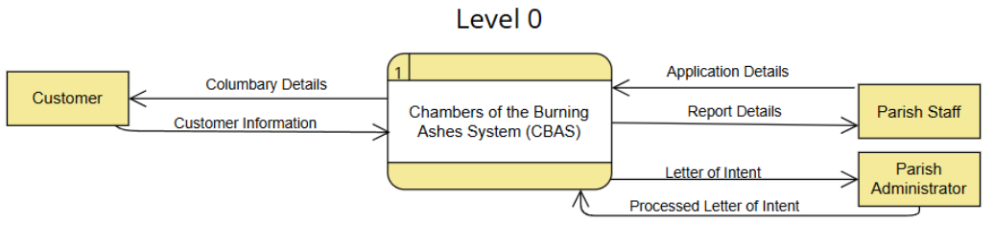
DATA FLOW Diagram

Slide 12
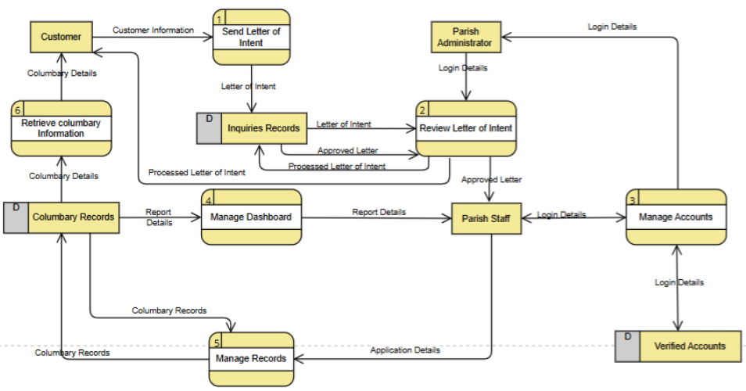
DATA FLOW Diagram

Slide 13
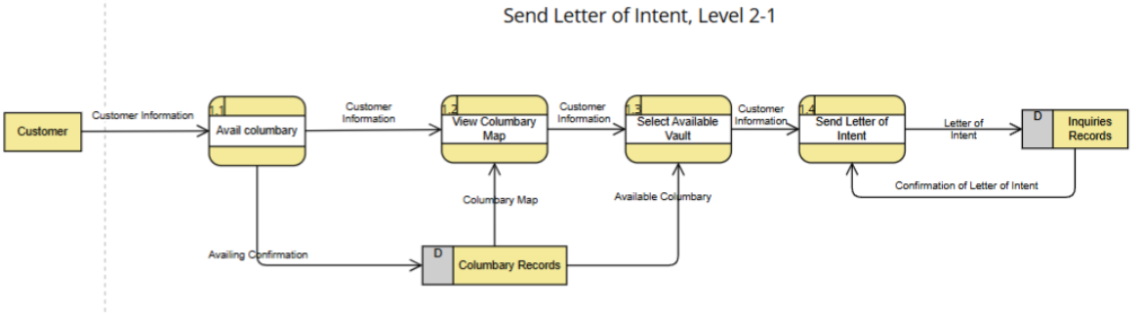
DATA FLOW Diagram

Slide 14
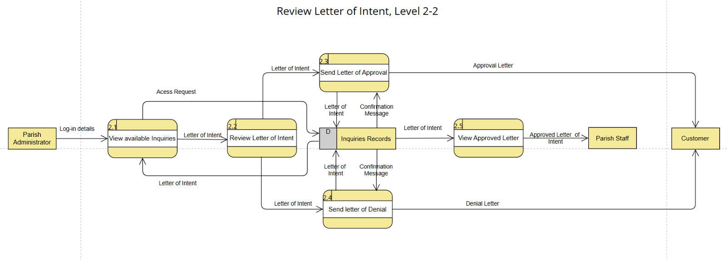
DATA FLOW Diagram

Slide 15
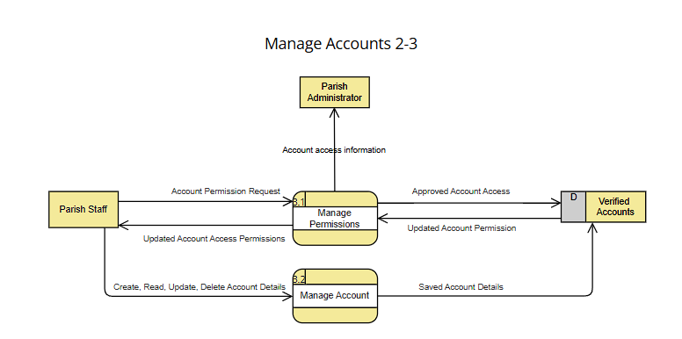
DATA FLOW Diagram

Slide 16
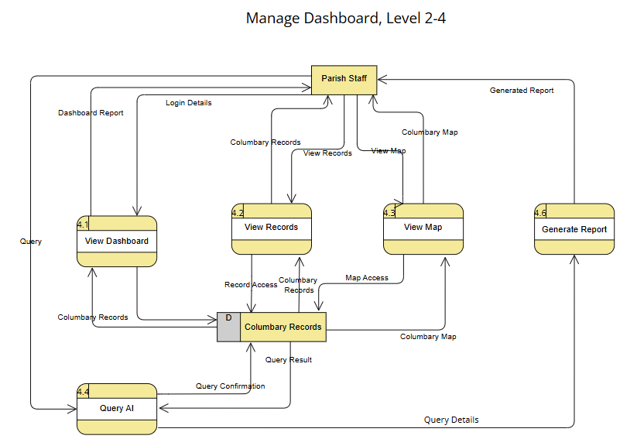
DATA FLOW Diagram

Slide 17
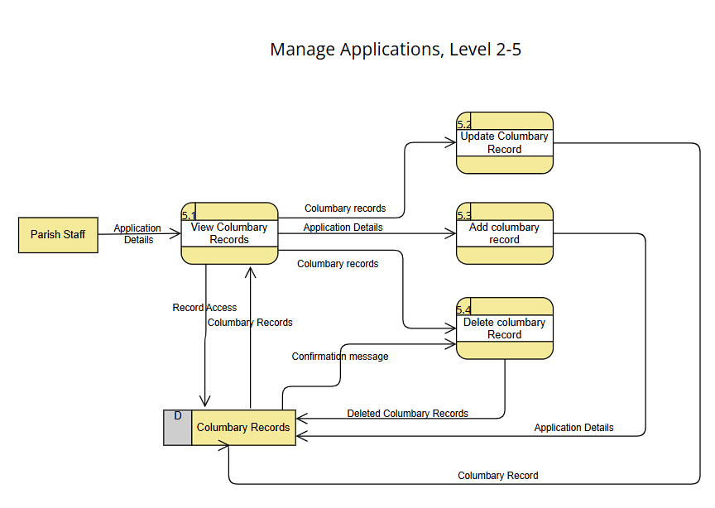
DATA FLOW Diagram

Slide 18
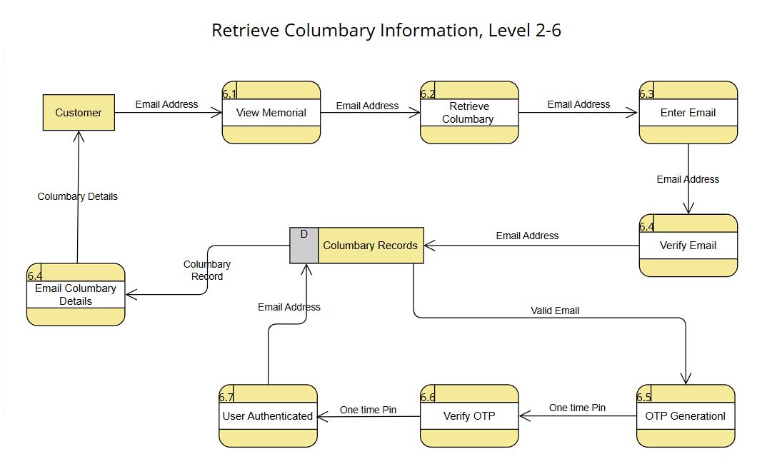
DATA FLOW Diagram

Slide 19
Use case & Fully Dressed
Team phishda

Slide 20
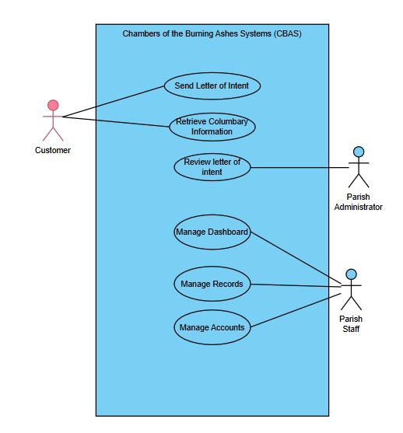
USE CASE DIAGRAM

Slide 21
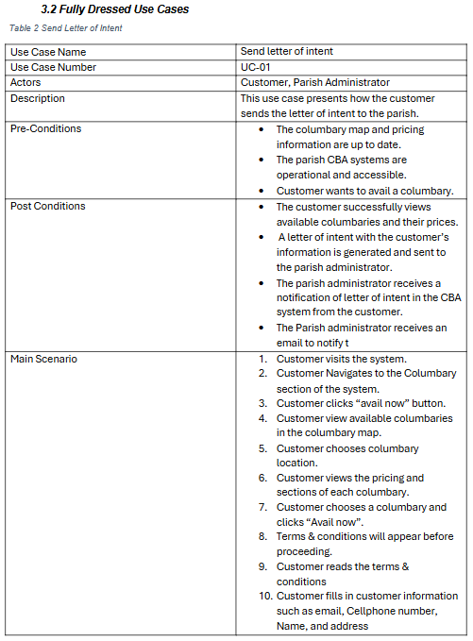
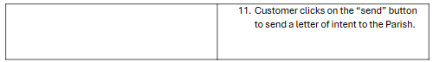
Fully dressed used case

Slide 22
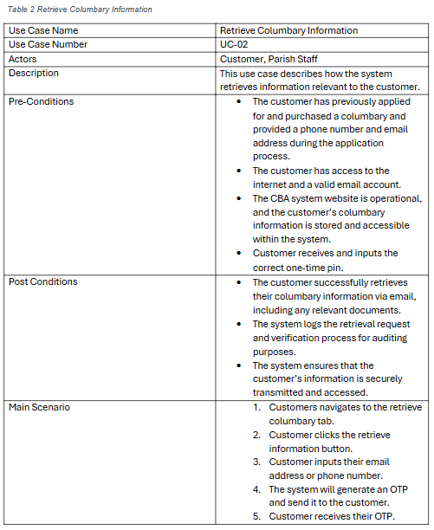
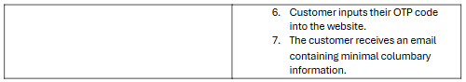
Fully dressed used case

Slide 23
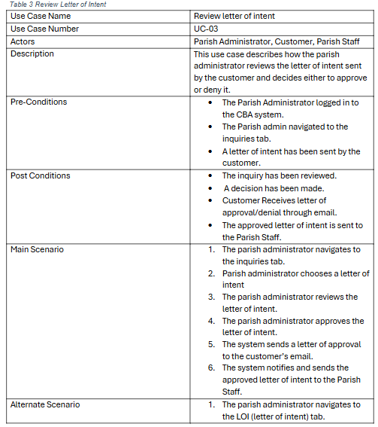

Fully dressed used case

Slide 24
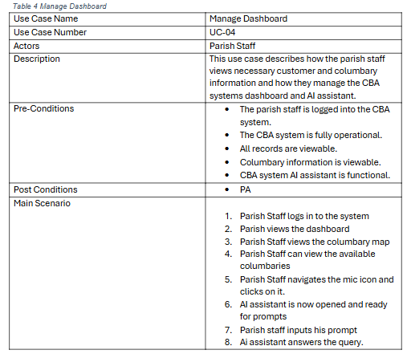
Fully dressed used case

Slide 25
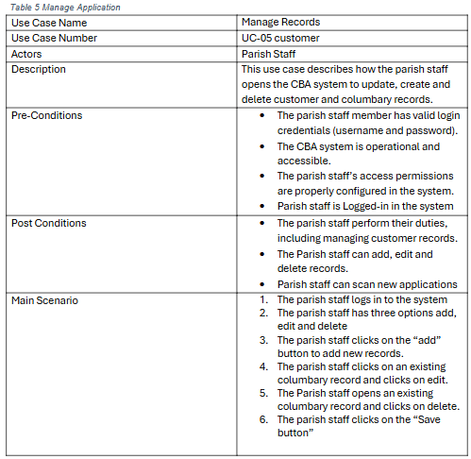
Fully dressed used case

Slide 26
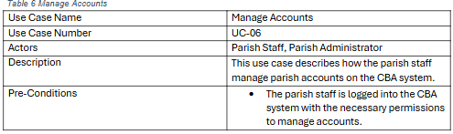
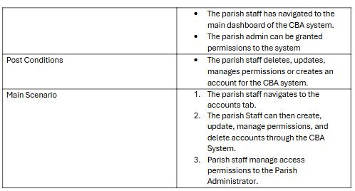
Fully dressed used case

Slide 27
Activity Diagram
Team phishda

Slide 28
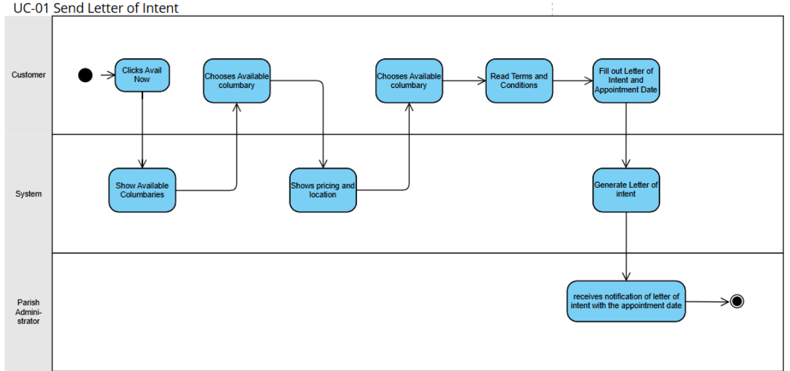
Swimlane

Slide 29
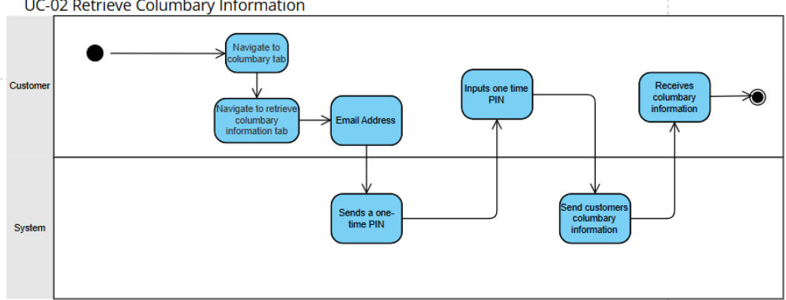
Swimlane

Slide 30
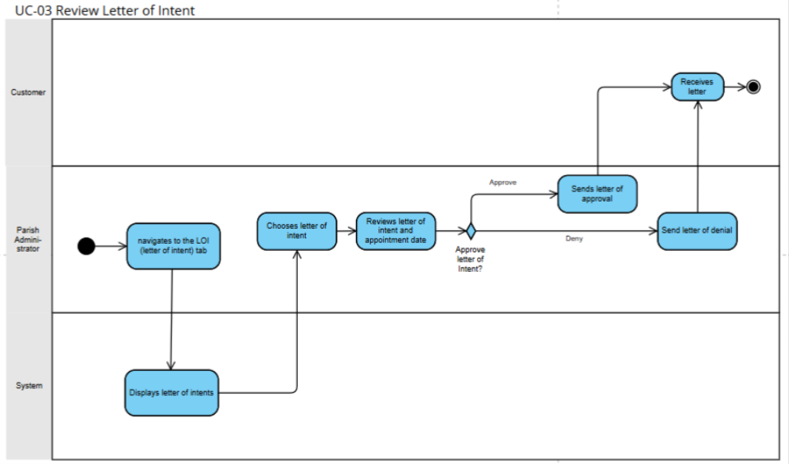
Swimlane

Slide 31
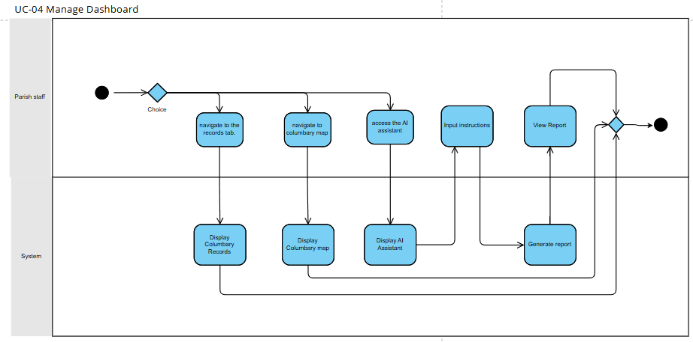
Swimlane

Slide 32
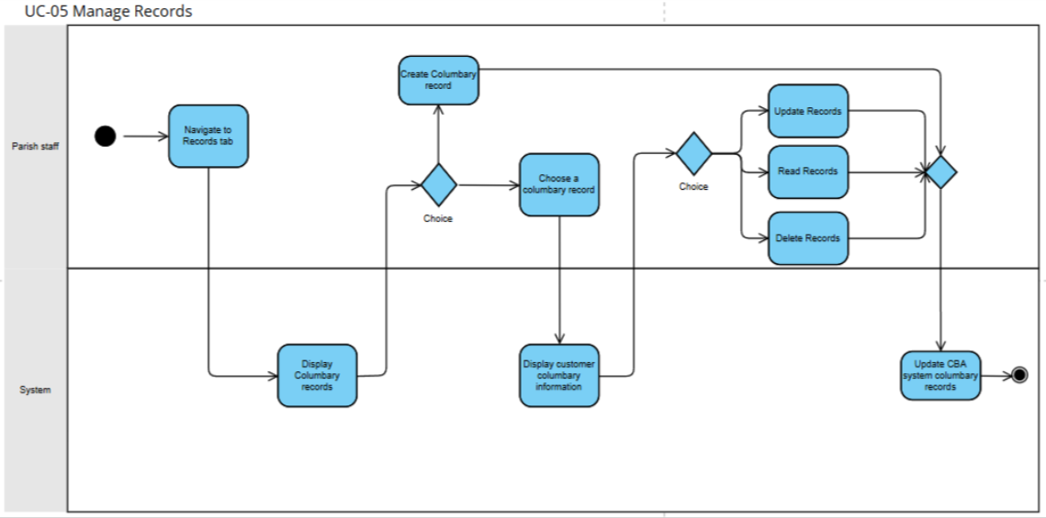
Swimlane

Slide 33
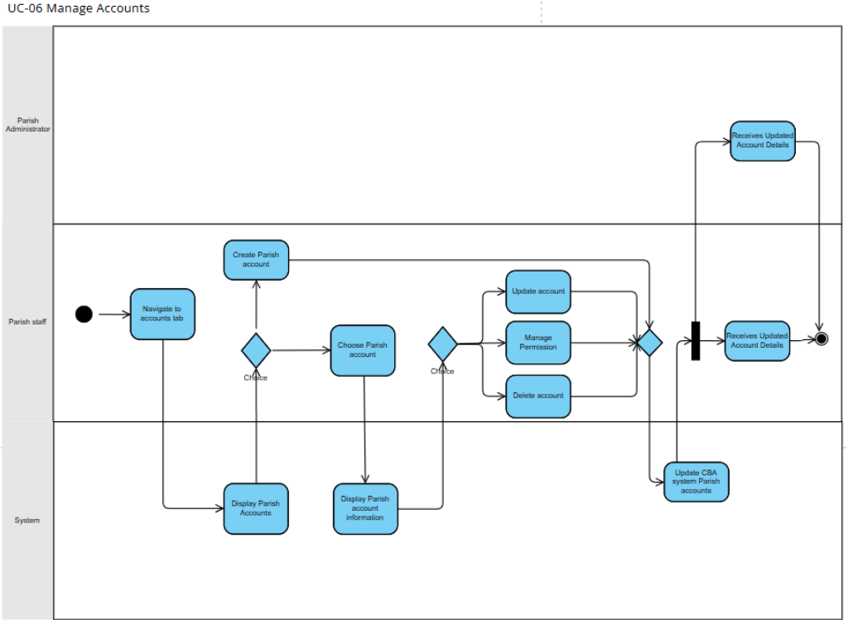
Swimlane

Slide 34
Entity Relationship Diagram
Team phishda

Slide 35
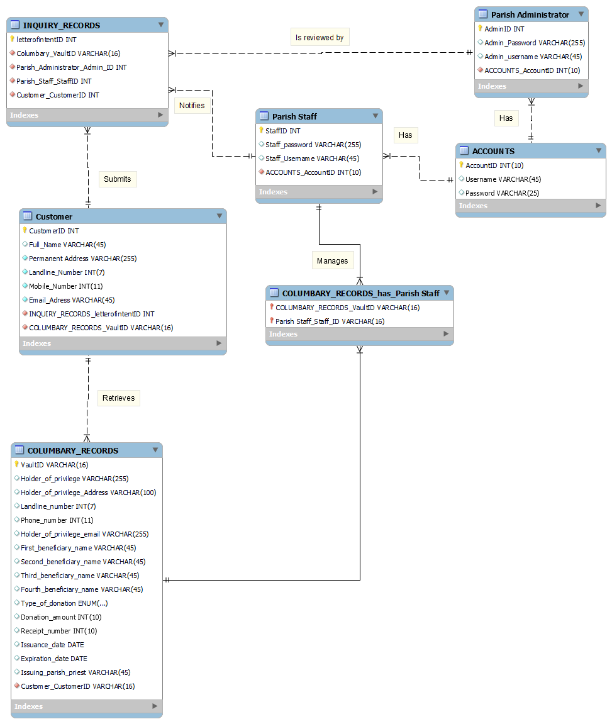
Entity Relationship Diagram

Slide 36
Prototype
Team phishda

Slide 37














Technology Stack
Frontend
Communications + Environment
Hosting
Backend + DB
Hardware + Cloud
OCR
Hosting service

Slide 38
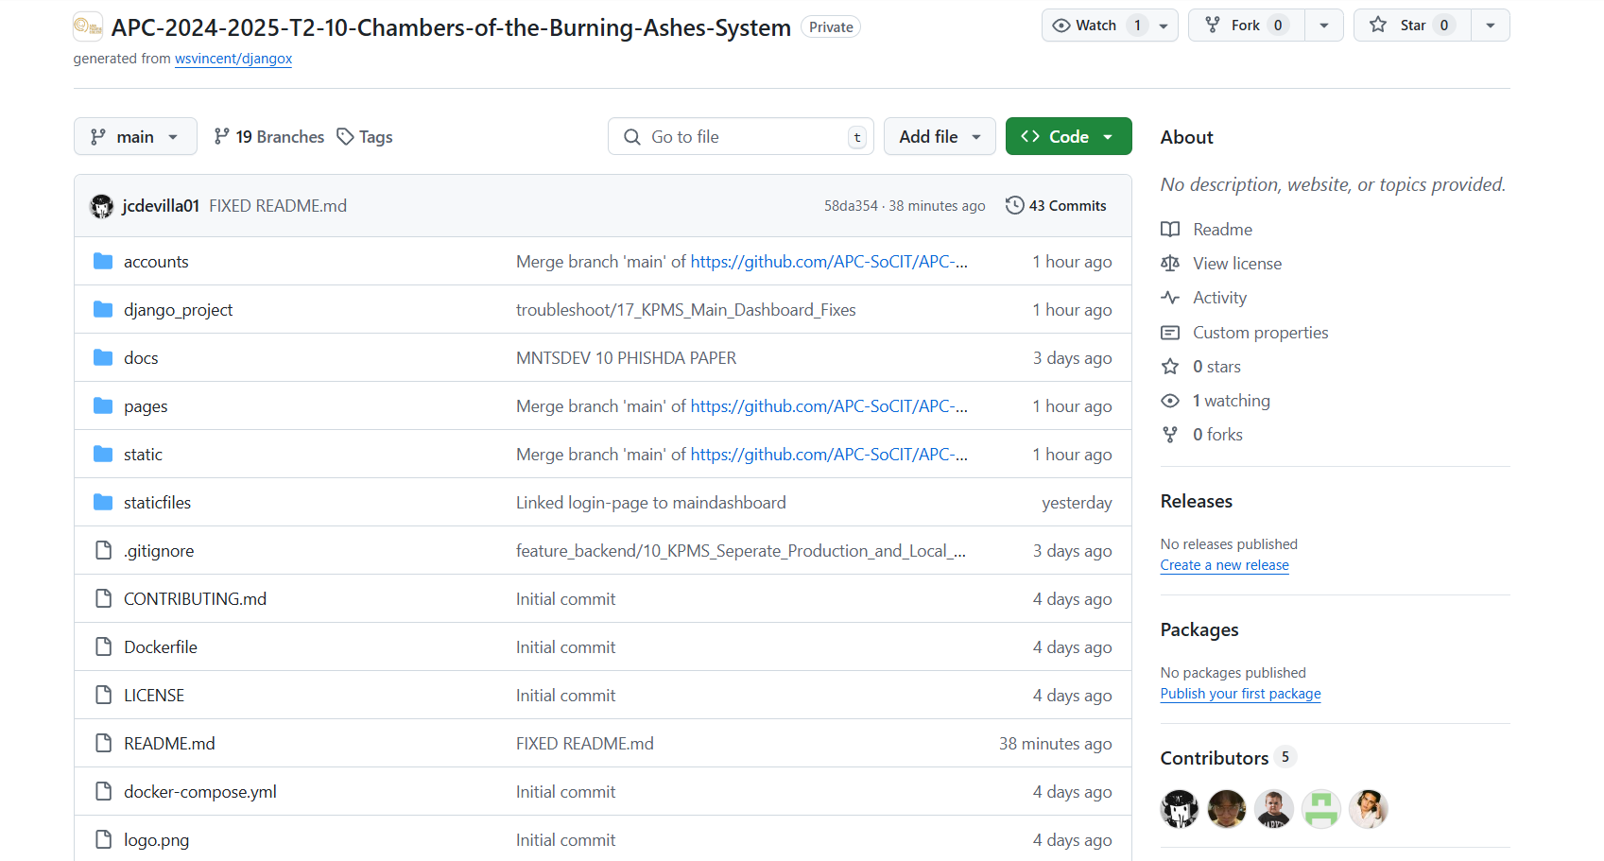
GITHub Repository
Link: https://github.com/APC-SoCIT/APC-2024-2025-T2-10-Chambers-of-the-Burning-Ashes-System

Slide 39
Working prototype

Slide 40
Group COntributionS
Team phishda

Slide 41
